Slide 1
Send A Snack
Pedro Monteiro [97484]
Daniela Dias [98039]
Hugo Gonçalves [98497]
Eduardo Fernandes [98512]
TQS 2021/2022

Slide 2
01
Product Concept

Slide 3

SendASnack Core
SendASnack Store
SendASnack Core is a deliveries platform that empowers traditional businesses to easily create deliveries for their products by using SendASnack’s riders taskforce.
SendASnack Store is a food store that sells Hamburgers and other consumables. It uses the SendASnack Core to make deliveries of their products.

Slide 4
02
Architecture

Slide 5
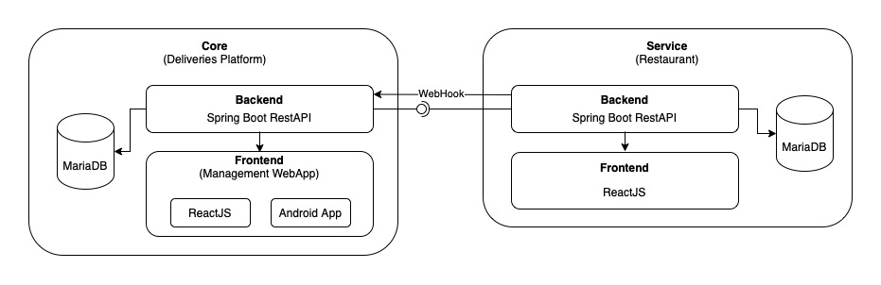

Slide 6
03
Features

Slide 7
SendASnack Core
Create new orders as Business
Change Order Status as Business
Admin panel for Businesses
Accept/Reject Deliveries as Rider
Change Availability as Rider
WebHooks to update orders status

Slide 8
SendASnack Store
Cart for Products
Add/remove products as a admin
Update profile settings
Purchase products
Get orders history
WebHooks to update orders status

Slide 9
04
QA Strategy

Slide 10
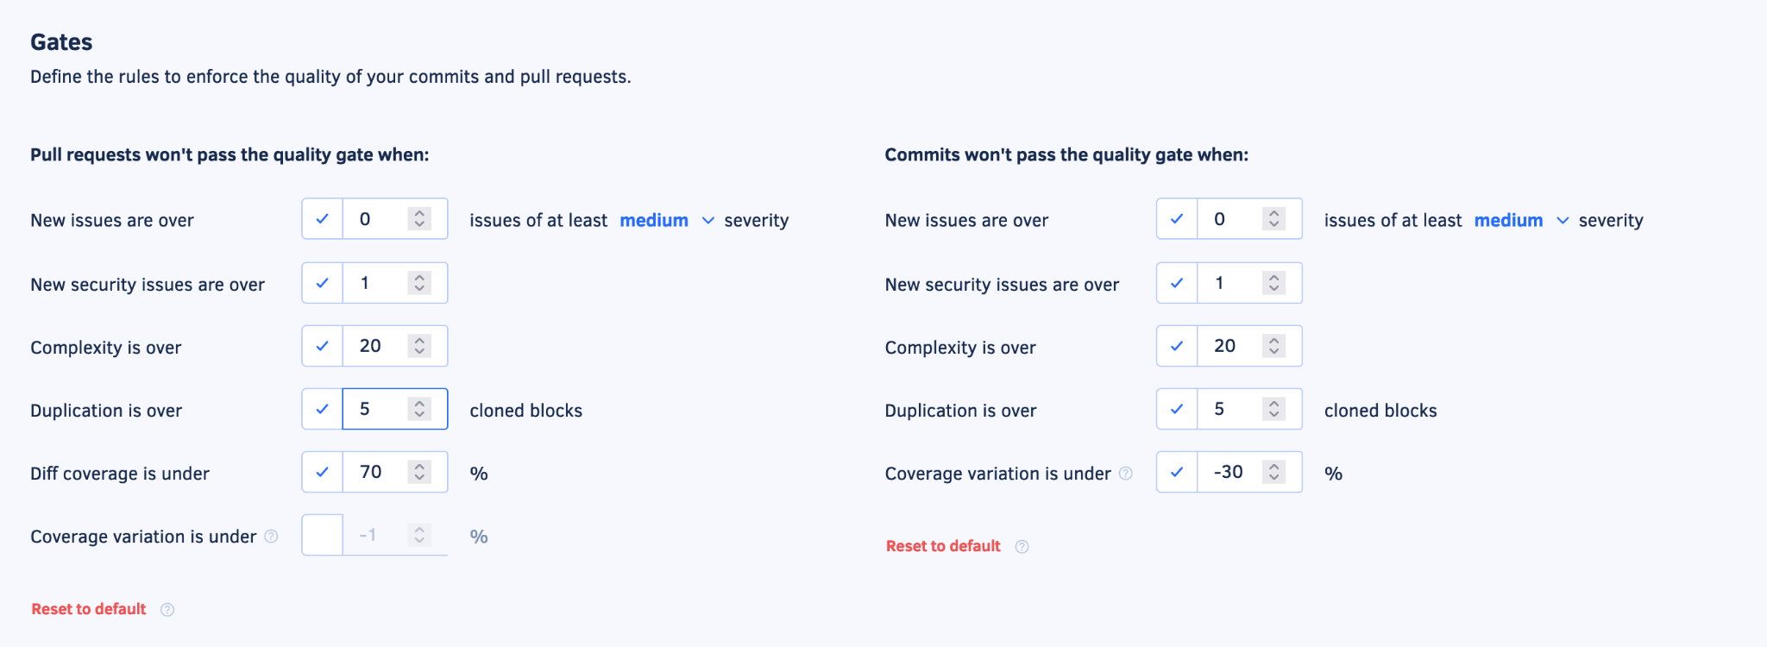
Static Code Analysis
The Static Code Analysis was performed using Codacy;
Quality Gates

Slide 11
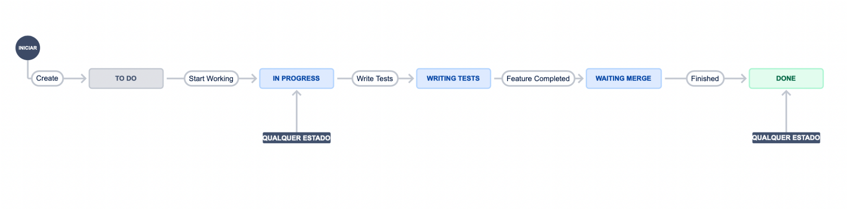
Management Tool
To manage the sprints, user stories and tasks we’ve used JIRA.
The tasks were written as User Stories, Tasks or Issues and were associated with a team member that would be responsible for implementing/fixing the user story or issue.
Jira Workflow

Slide 12
CI and CD
Our project modules were deployed in Azure Cloud.
The CI and CD pipeline was powered by CircleCI, and it allowed us to deploy new feature when they were either on master or develop branches.
An example of a config.yml file that contains the CI and CD pipeline is available on:
https://github.com/SendASnack/core_backend/blob/main/.circleci/config.yml

Slide 13




Testing Technologies

Slide 14
05
Demo

